Slide 1
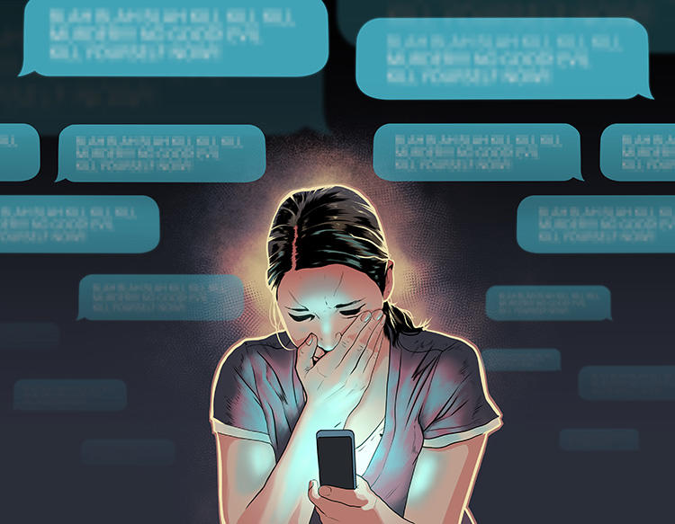
Regulating online harassment
Liz Farries
UCD
@e_farries
fevatv, 2014

Slide 2

Director, MSc Digital Policy at UCD Senior Fellow, UCD Centre for Digital Policy Senior Fellow, International Network of Civil Liberties Organizations

Slide 3
Today’s lecture
The hopes and ideals of online spaces vs the risks and harms
Introducing image-based sexual abuse
Journalist Dara Quigley’s experience and subsequent legal reform
This class is dedicated to Dara Quigley, her mother Aileen Malone, and those who seeks to revolutionise safe spaces for everyone.

Slide 4
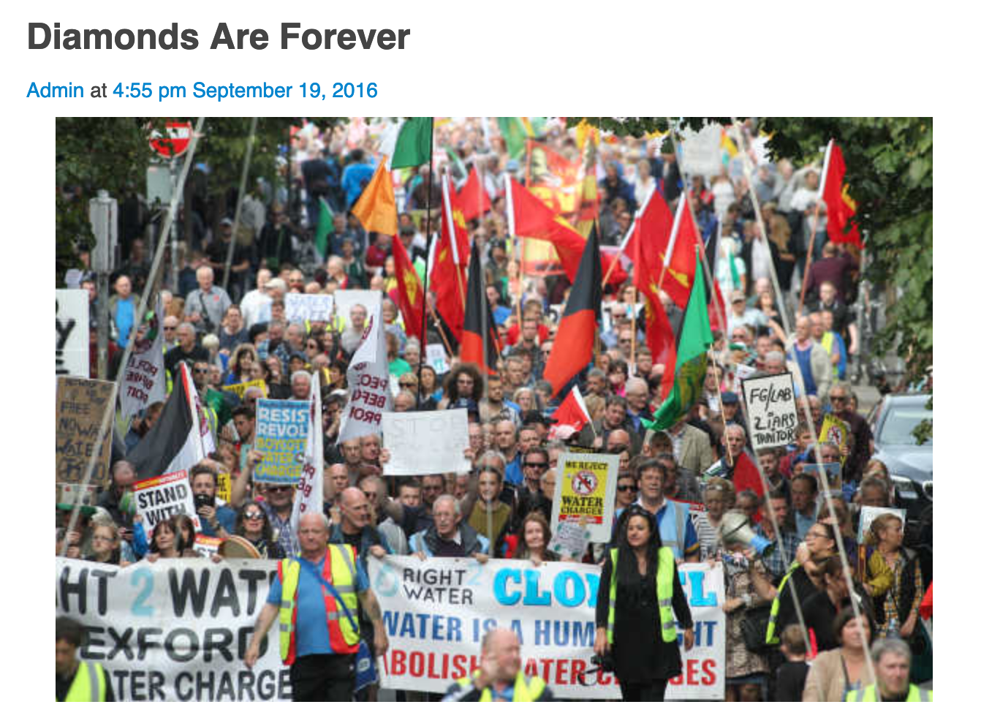
Dara Quigley wrote
‘Our economy and society is modeled on the behaviour of pigeons, survival of the fittest, everybody out for themselves.
The reality is more complex and beautiful than this regime can possibly imagine.
In reality, we are more like a flock of starlings, producing intricate, amazing patterns all arising from one fundamental rule: no one bird is allowed to get lost.’
- Dara Quigley, 2016
Source: https://www.broadsheet.ie/2016/09/19/diamonds-are-forever/

Slide 5
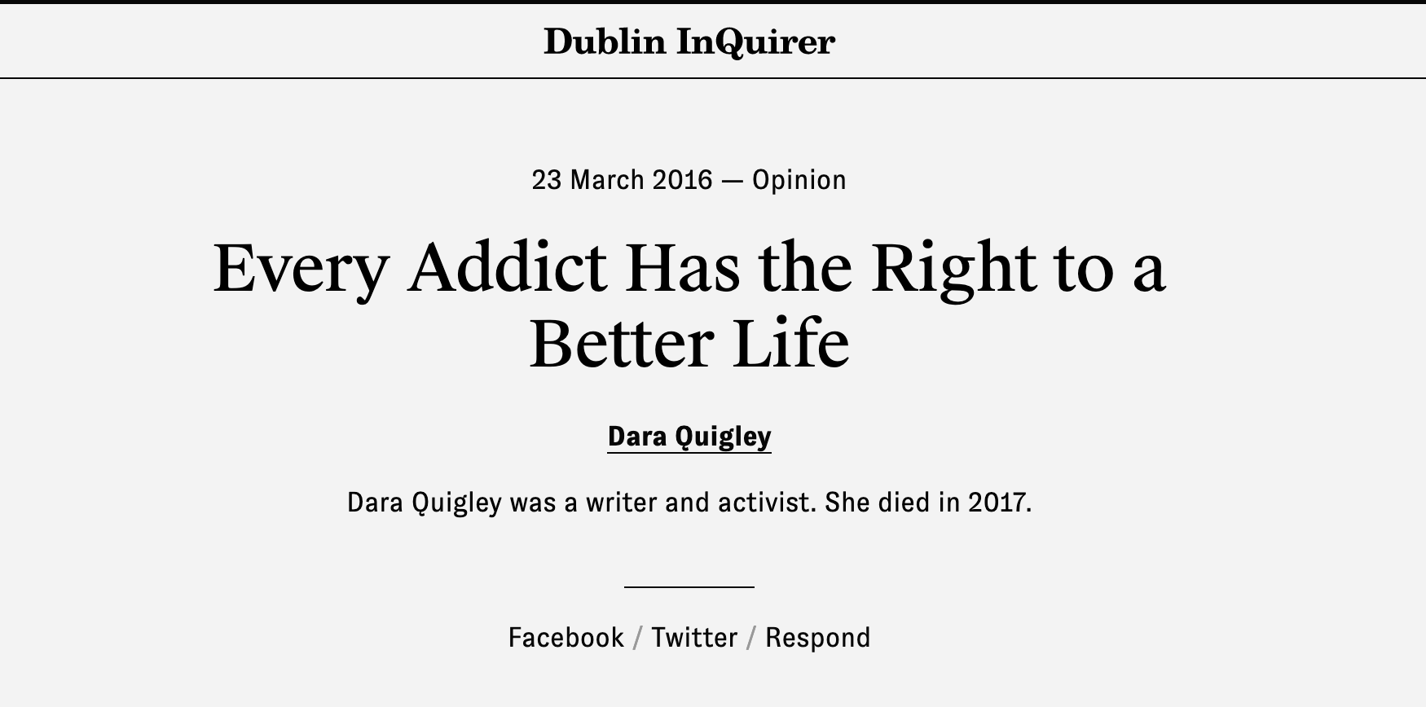

Slide 6
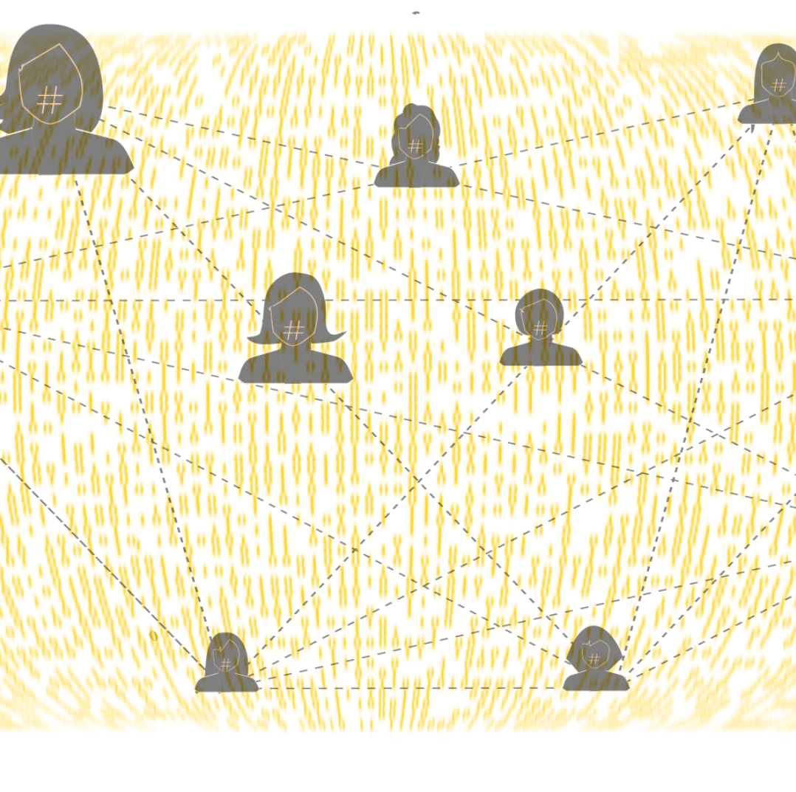
ICT: a revolutionary spaces for gender equality?
Donna Haraway (Manifesto, 1991)
New Information Communication Technologies (ICT) could create spaces for equality
Possibilities for coalitions based on affinities, not identities
Opportunities for uniquely safe spaces online

Slide 7

Lived realities
Mary Anne Franks (2015)
Harassment online undermines the progressive social potential of spaces online
The internet amplifies abuse

Slide 8

Online harassment types…share non personal examples in chat
I’ll start with doxing (aka doxxing)

Slide 9

Terminology is important…
Is it ‘cyberbullying’ or ‘cybermisogny’?
Cybermisogyny…encapsulates the diverse forms of gendered hatred, harassment, and abusive behaviour directed towards women and girls online.
It offers a more nuanced way of describing behaviours often lumped into the catch-all term ‘cyberbullying’ in mainstream discourse, a term which tends to erase the sexist, racist, homophobic, transphobic, and otherwise discriminatory nature of the behaviour and ignores the context of power and marginalization in which it occurs.
Westcoast Leaf (2014)

Slide 10
Terminology is important…
Is it image-based sexual abuse or revenge porn?
It’s not porn it’s abuse
Motivations unrelated to revenge
Clear intent is to violate a person’s personal autonomy, dignity, and privacy in a sexualized way
McGlynn and Rackley (2017)
#Image-Based Sexual Abuse

Slide 11
Image-based sexual abuse
An established problem with gendered harms
Historically, the majority are women and the majority of perpetrators are men
However, intersectional factors increase the likelihood of experiencing online harassment like image-based sexual abuse
The LGBT+ community is at increased risk. One's race, religion, ethnicity, mental health and ability are all risk factors.
Farries and Sturm (2019)

Slide 12
Devastating Harms
Mary Anne Franks (2011)
Images dominate search engines
Materials sent to victim’s communities
Threats, further harassment, employment termination, suicide
Unwilling Avatars

Slide 13
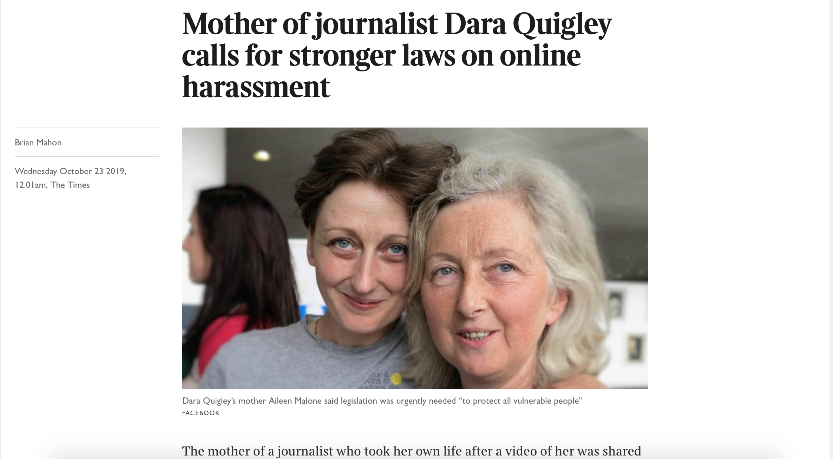
Dara Quigley’s experience

Slide 14
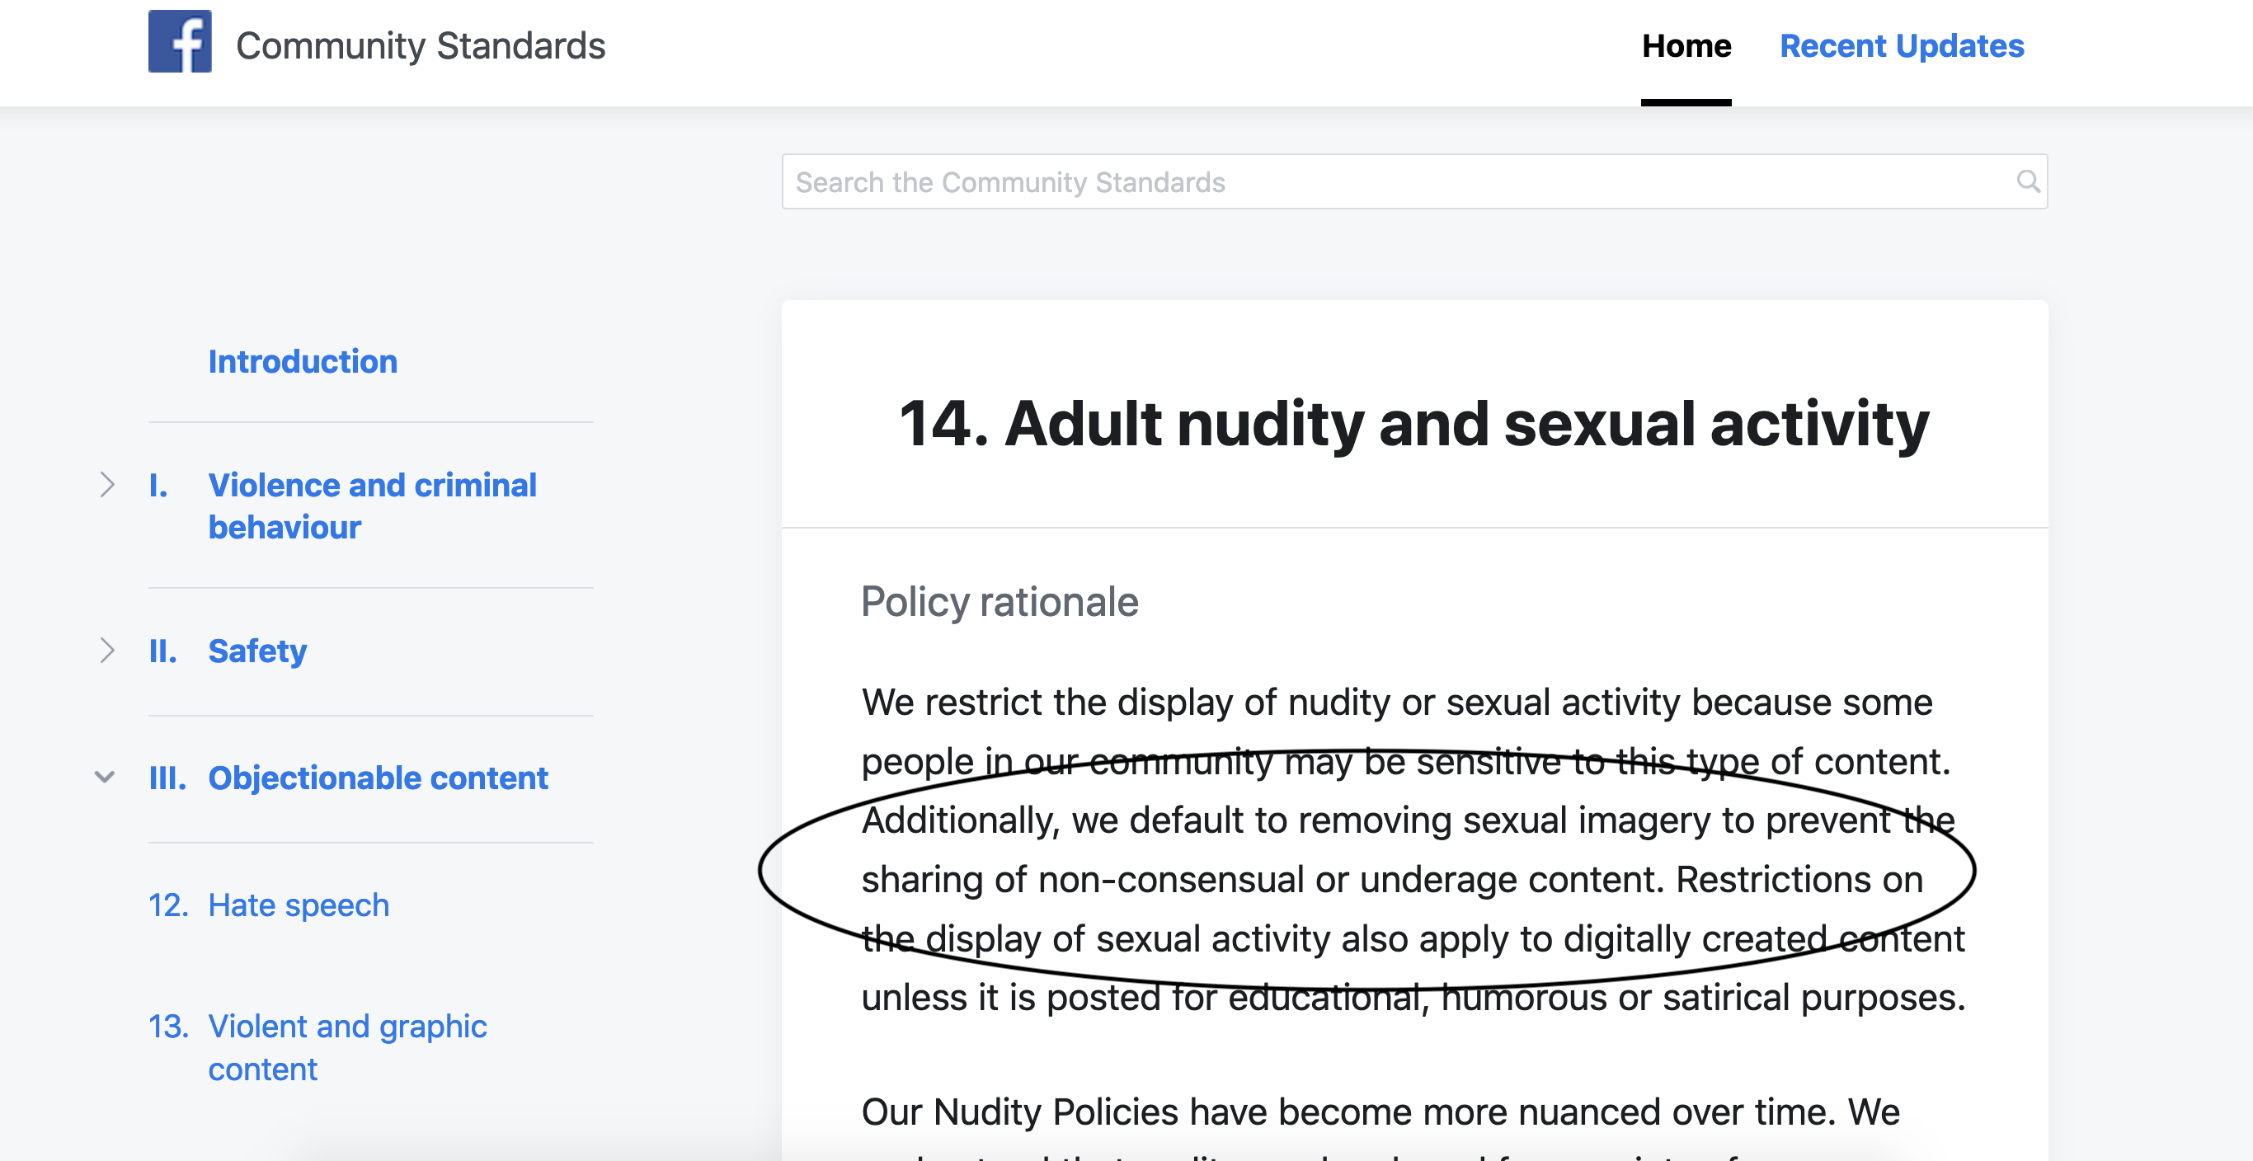

Slide 15
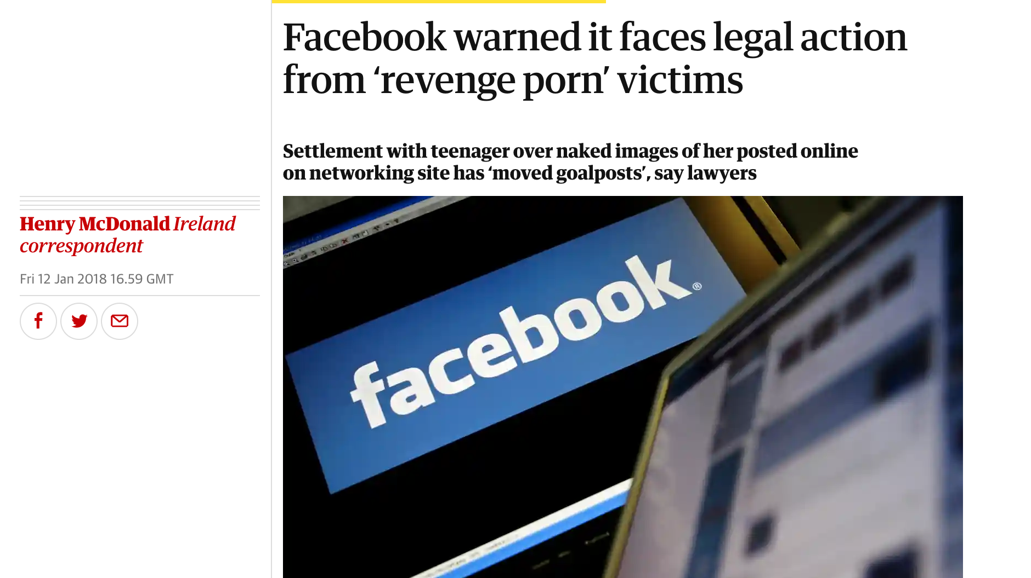
Source: https://www.theguardian.com/technology/2018/jan/12/facebook-faces-legal-action-from-victims-of-revenge-porn

Slide 16
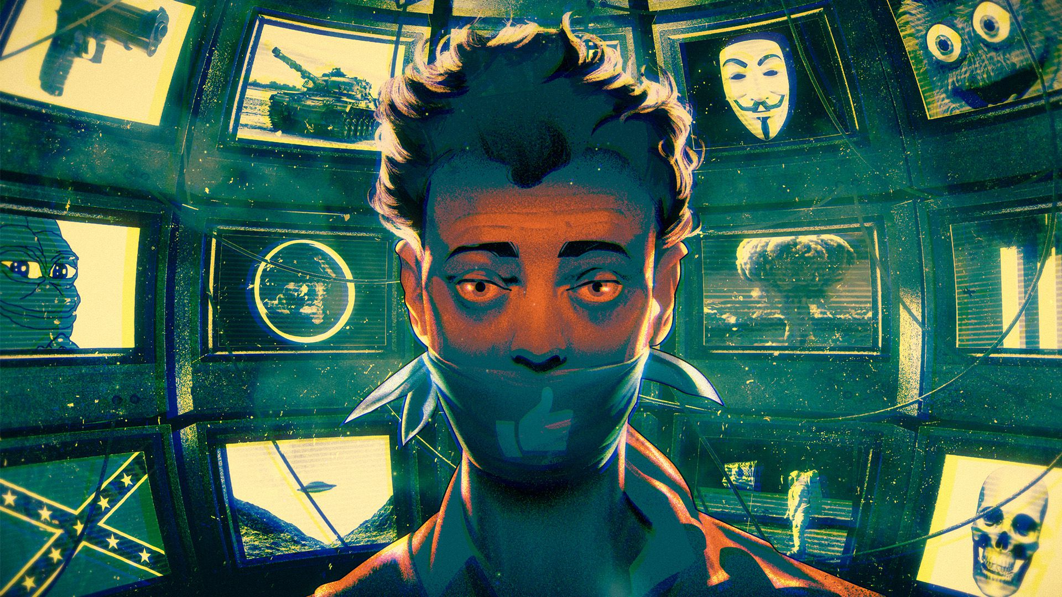
Human Content Moderation problems: ‘bodies in seats’ (Verge, 2019)
Source: https://www.theverge.com/2019/6/19/18681845/facebook-moderator-interviews-video-trauma-ptsd-cognizant-tampa

Slide 17
Platforms shouldn’t be the de facto regulators
Content and speech are traditionally the purview of government and judicial mechanisms
Not entirely clear how social media companies regulate content despite their public facing policies
2016 report, UN Special Rapporteur freedom of expression: Private companies ‘are typically ill-equipped to make determinations of content illegality’ (A/HRC/32/38)
Council of Europe Commissioner for Human Rights: ‘States should stop relying on private companies that control the Internet to impose restrictions that violate States’ human rights obligations’ (2014)

Slide 18
Remedies for IBSA
Four broad remedies emerging (O’Connell, 2020)
Criminal Law
Privacy law
Copyright law
Image-rights

Slide 19
Remedies in Ireland before 2021
Right to have one’s data erased
Under 18: Criminal Law (Sexual Offences) Act 2017 s12
Data Protection Commissioner

Slide 20
Research, lobbying and recommendations
Law Reform Commission Report on Harmful Communications and Digital Safety (2016)
Private Members’ Bill
TD Howlin
Aileen Malone and Irish Council for Civil Liberties
Efforts and experiences of many others

Slide 21
Times, 2019 https://www.thetimes.co.uk/article/mother-of-journalist-dara-quigley-calls-for-stronger-laws-on-online-harassment-wfbcwssc6

Slide 22
Harassment, Harmful Communications and Related Offences Act, 2020
Entered into force in February 2021
Criminalises image-based sexual abuse
Makes it an offence under section 3 for a person to record, distribute or publish an intimate image of another person without that other person’s consent

Slide 23
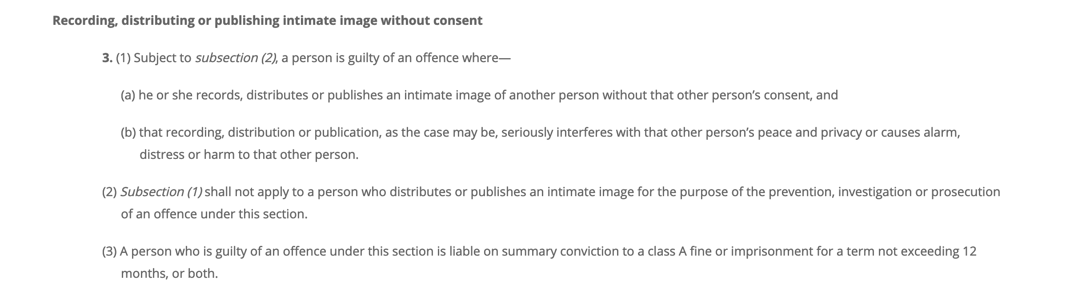
A strict liability offence (intention not a factor)
Harassment, Harmful Communications and Related Offences Act, 2020

Slide 24
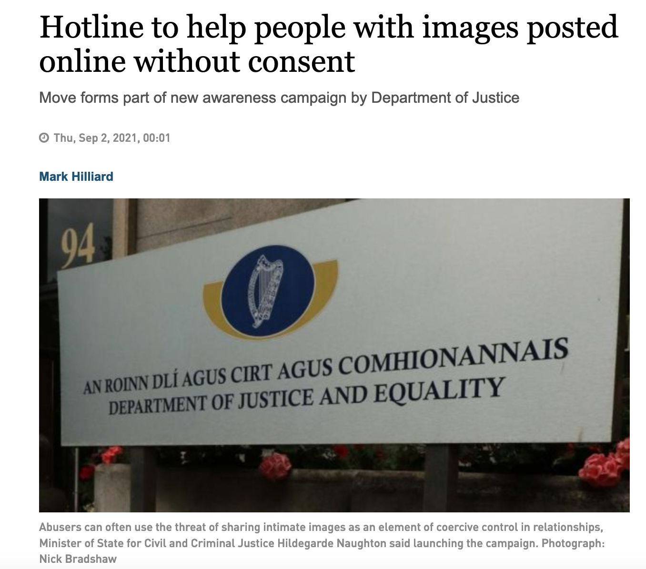
Hotline available: hotline.ie/report
https://www.irishtimes.com/news/social-affairs/hotline-to-help-people-with-images-posted-online-without-consent-1.4662497

Slide 25
Unanswered regulatory questions
CCTV
Policy measures must be in place to ensure that CCTV recordings are safe and secure and necessary
Reframing Irish Policing
To ground it in principles of human rights that include online and gendered considerations

Slide 26
Unanswered regulatory questions: Policing
The Director of Public Prosecutions (DPP) did not recommend prosecution of the garda who accessed Dara Quigley’s footage
That Gard also resigned from the force before a disciplinary process was complete
However, following the activism around Dara’s death, Garda Commissioner Drew Harris has apologised for the ‘unacceptable breach of trust’ committed in Dara’s case
Irish Times, 2021 https://www.irishtimes.com/news/social-affairs/harris-apologises-for-unacceptable-breach-of-trust-in-dara-quigley-case-1.4692032

Slide 27
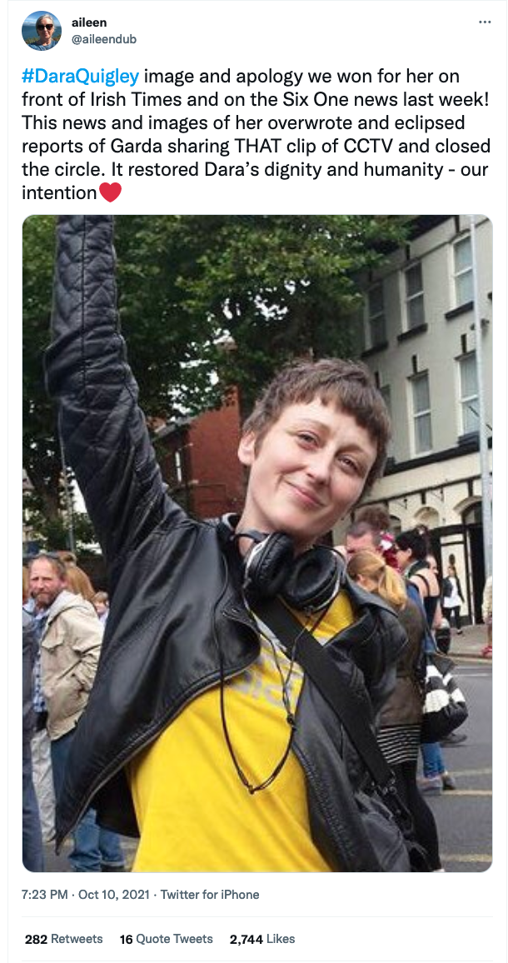

Slide 28
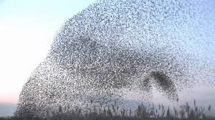
Recall Dara’s vision for society
‘We are more like a flock of starlings, producing intricate, amazing patterns all arising from one fundamental rule: no one bird is allowed to get lost’
(2016)
Realizing the vision of Haraway, Plant and Sade for affinity coalitions online
Source: https://www.broadsheet.ie/2016/09/19/diamonds-are-forever/

Slide 29
‘Fly high, Starling’ - Aileen Malone to Dara

Slide 30

Thank you!
elizabeth.farries@ucd.ie
If you need to talk: UCD's qualified student counselling service: https://www.ucd.ie/studentcounselling/contact/

